Slide 1

无人机航拍场景下的语义三维重建
陈煜1701213988@pku.edu.cn
王尧 wangyao@pku.edu.cn
王旭普 wxp@pku.edu.cn

Slide 2
CONTENTS
Semantic Segmentation
Structure from Motion
Results Display
PART ONE
PART TWO
PART THREE

Slide 3
Division & Cooperation
Name
Student ID
Work
陈煜
1701213988
稀疏点云模型生成
王尧
1701214012
语义分割
王旭普
1701214013
前端结果展示

Slide 4
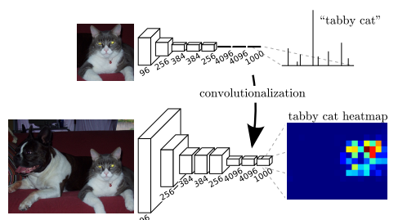
Semantic segmentation
FCN: Transforming fully connected layers into convolution layers

Slide 5
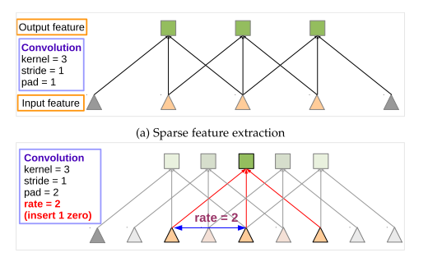
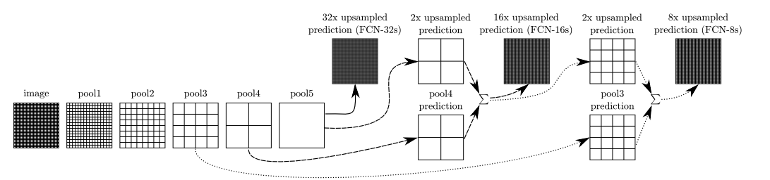
from FCN to Deeplab
问题 | deeplab解决方案
特征图（feature map）分辨率过低 | 膨胀卷积(Atrous convolution)
多尺度物体 | 膨胀金字塔池化(Atrous spatial pyramid pooling )
池化后不能准确反映位置 | 全链接条件随机场(Fully connected CRF)
Atrous(dilated) convolution

Slide 6
Dataset Construction
Data selection
Semantic labeling
Post process
Enrich the variety from different:
Drone height
Light(shadow)
Camera angle
Image content
The labeling pipeline is:
By photo shop
Semi-automatic
5 min per image
The main goals are:
To combine semantic masks into single ground truth label
To deal with multi-labeled/unlabeled pixel
Train_set | Validation _set
156 | 30

Slide 7
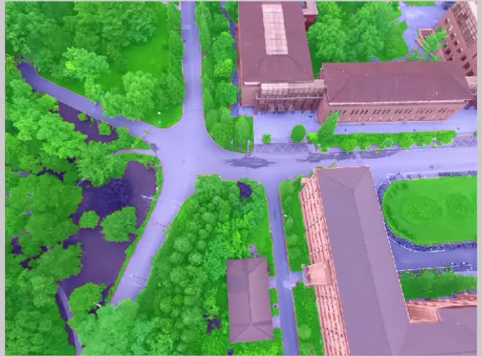
Dataset glimpse

Slide 8
Training
Hyper Parameters
Backbone network | Resnet-101
Crop size | 513*513
Init Learning rate | 1e-4
batch size | 12
Weight decay | exp 0.98
Max epoch | 10
Result
MIoU | 88.7
Mean accuracy | 94.1

Slide 9
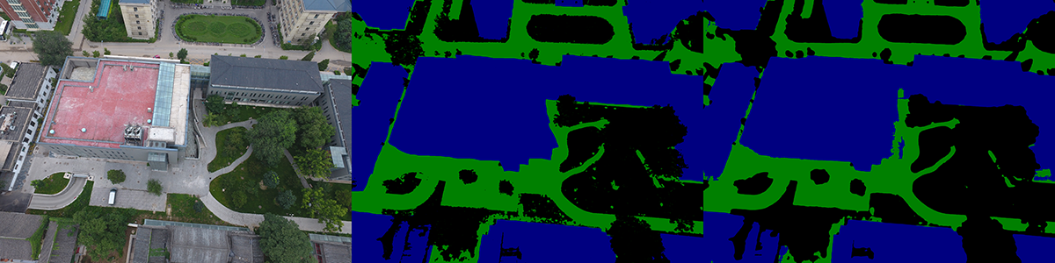
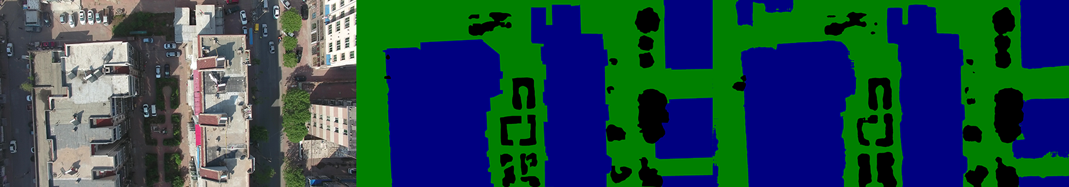
Result
campus
huludao

Slide 10
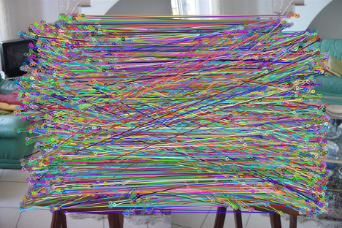
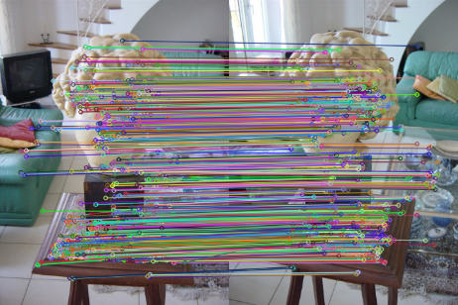
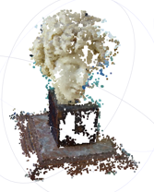
Pipeline for SfM
Pictures
Feature Matching
Geometric Verifying
Initial Pair Selection
Bundle Adjustment
Triangulation
Camera Registeration
sparse model

Slide 11
Two Main Bottlenecks
60%
30%
Feature Matching
Bundle Adjustment

Slide 12
Semantic Feature Extracts
- SIFT keypoint detector
- Extract semantic label by semantic segmentation result
- Group features by semantic label, then perform feature matching

Slide 13
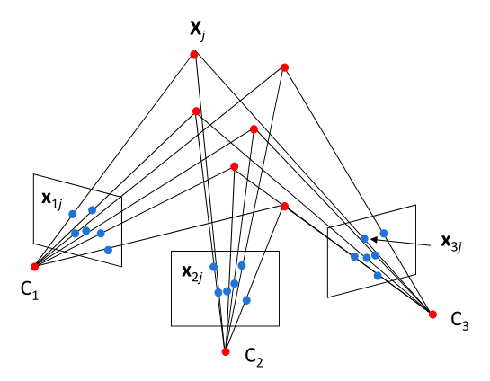
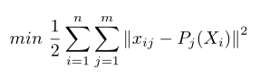
Unonstrained Bundle Adjustment
- Unconstrained Bundle Adjustment
- Solved by Levenburg-Marquart approach

Slide 14
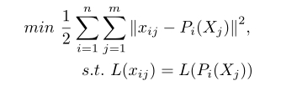
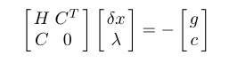
Constrained Bundle Adjustment
- Constrained Bundle Adjustment
- Solved by Sequential Quadratic Programming

Slide 15
Reconstruction Results
Original SfM
Semantic SfM
Dataset
Views
Poses
Residuals
RMSE
Views
Poses
Residuals
RMSE
PKU-m1
52
52
388096
0.421443
52
52
274027
0.376776
PKU-e3_3
60
60
272143
0.524914
60
60
178258
0.490911
Heda-Dalitang
97
97
789944
0.318991
97
97
689435
0.304753

Slide 16
Result Display
使用nodejs搭建一个本地网站进行结果展示
使用multer来处理文件的上传
使用WebGL来处理模型的导入
使用three.js来导入模型，读取模型的点位置
使用PointsMaterial来渲染模型的颜色
使用canvas在web页面展示模型
使用controller来添加模型控制，可以对模型进行旋转平移操作

Slide 17
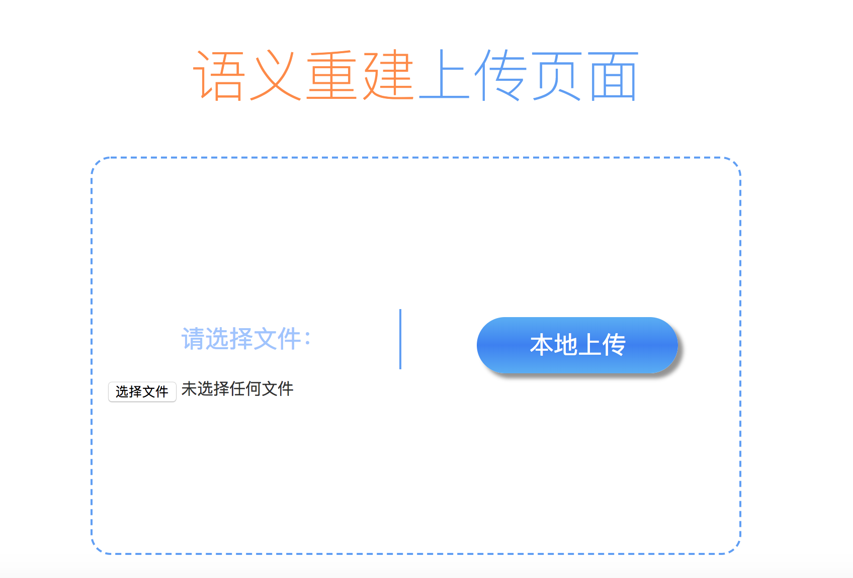
Model Upload

Slide 18
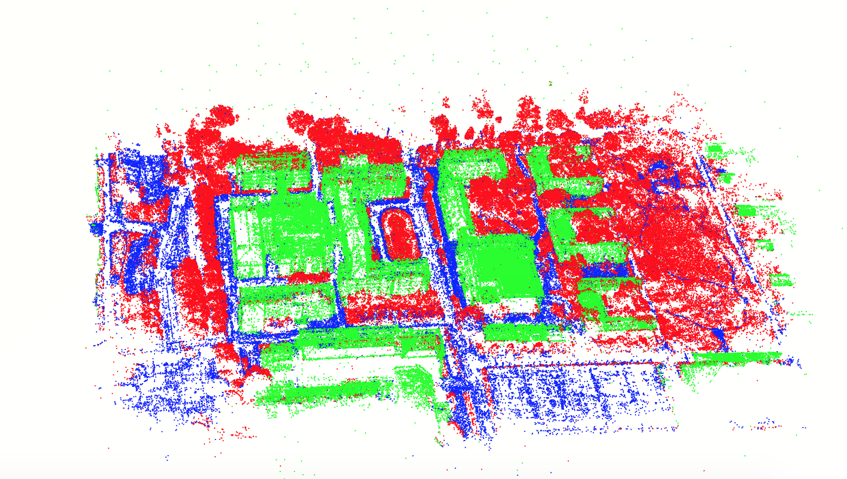
Model Display

Slide 19
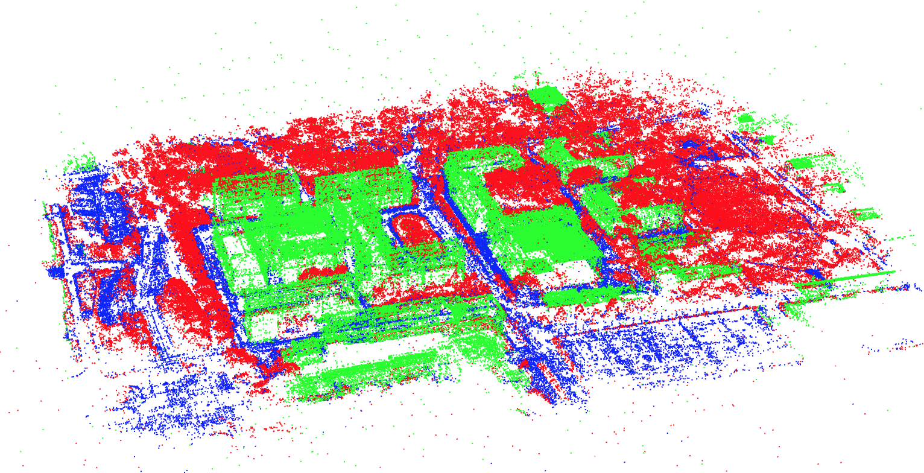
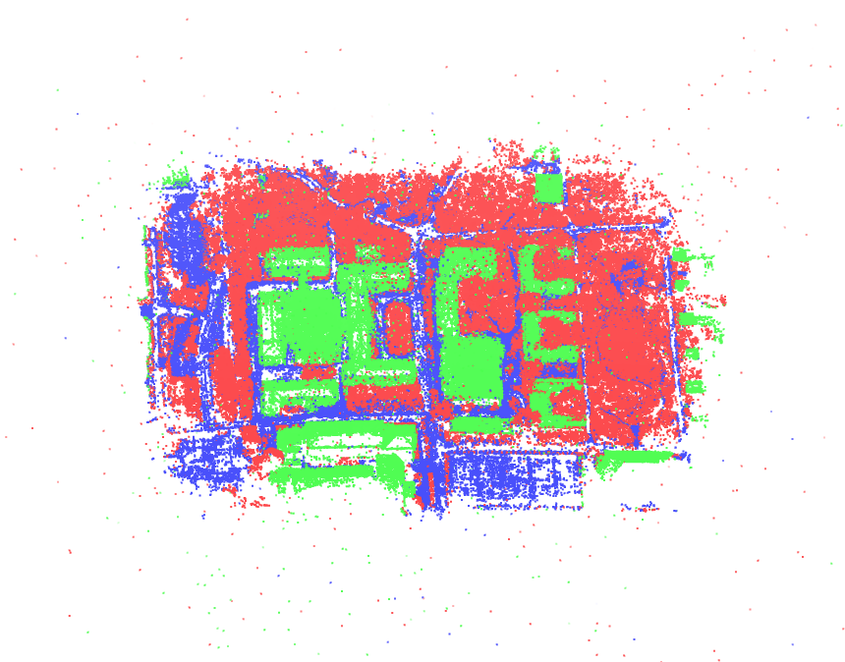
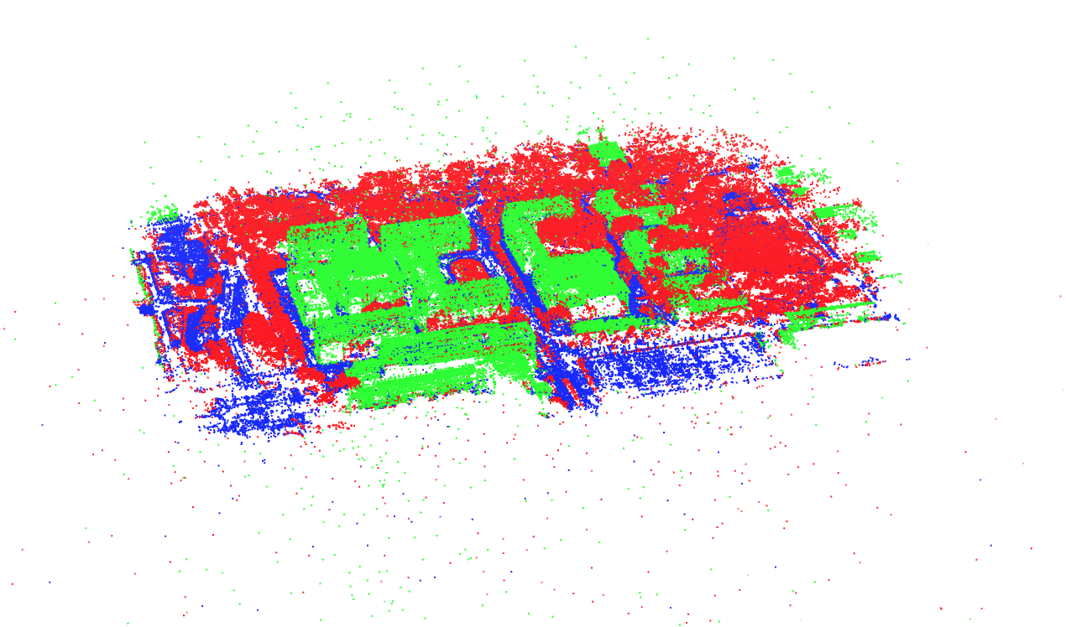
Model Display

Slide 20
Future Work
- Learning semantic features
- Dense reconstruction for automatic semantic segmentation

Slide 21
References
[1] Noah Snavely, Steven M. Seitz, Richard Szeliski. Photo Tourism: Exploring image collections in 3D. ACM Transactions on Graphics (Proceedings of SIGGRAPH 2006), 2006.
[2] Snavely K N. Scene reconstruction and visualization from internet photo collections[M]. University of Washington, 2008.
[3] Schönberger J L, Frahm J M. Structure-from-Motion Revisited[C]// Computer Vision and Pattern Recognition. IEEE, 2016.
Notes:
模板来自于 http://www.ypppt.com

Slide 22
THANKS FOR LISTENING

